Slide 1
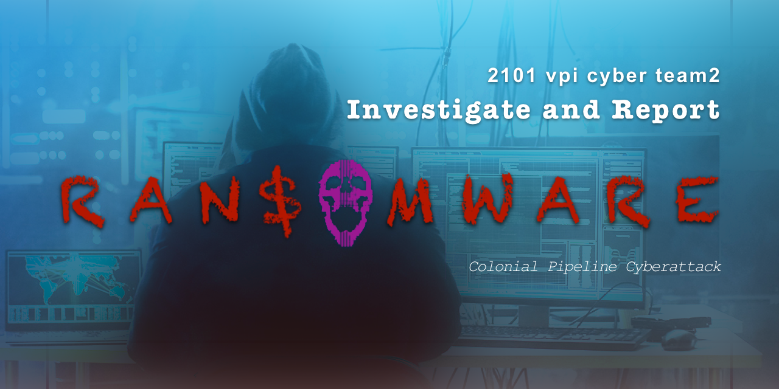

Slide 2

Casey M.
INTRO
Ransomware Definition
Darkside Group (?)

Slide 3

Intro

Slide 4
What is Ransomware?

Slide 5
Darkside Group

Slide 6
Kim Y.
Decision to shut down pipeline
Decision to pay the ransom
Impacts

Slide 7
Decision to shut down the pipeline
because the company didn’t know how much access the hackers might gain, safety was the first priority
prevent hackers from migrating to the pipeline control system.

Slide 8
Decision to pay the ransom
wanted to keep the situation confidential
wanted to get the pipeline back online as quickly as possible
https://www.bbc.com/news/business-57403214

Slide 9
Impacts
news of the attack and the pipeline shutdown spurred panic buying of gasoline, leaving thousands of gas stations without fuel, driving prices to the highest in almost 7 years
the US gasoline inventory would last about 27 days, the potential to severely disrupt travel and transportation is significant
paying the ransom is not advised as doing so provides the hackers with the ability to expand their capabilities and sets the expectation that they would be paid in future attacks

Slide 10
Impacts
increased cybersecurity regulation and inspection of pipeline systems translating to additional spending to more thoroughly protect pipelines from cyber attacks
air travel
HVAC
inspection of entire 5,500-mile pipeline for physical damage that may have occurred during the period in which electronic monitoring was offline

Slide 11
Rafael E.
Phishing
RDP Abuse
Vulnerabilities

Slide 12
Phishing
Email Scanning
Sandboxing
Awareness Training
Endpoint Protection

Slide 13
RDP Abuse
Stop Using RDP
See above
Seriously, use something else!
Add MFA

Slide 14
Vulnerabilities
Patching
Vulnerability Scanning/Management
Layered detection for Zero-Day Attacks
Low Privilege

